Slide 1
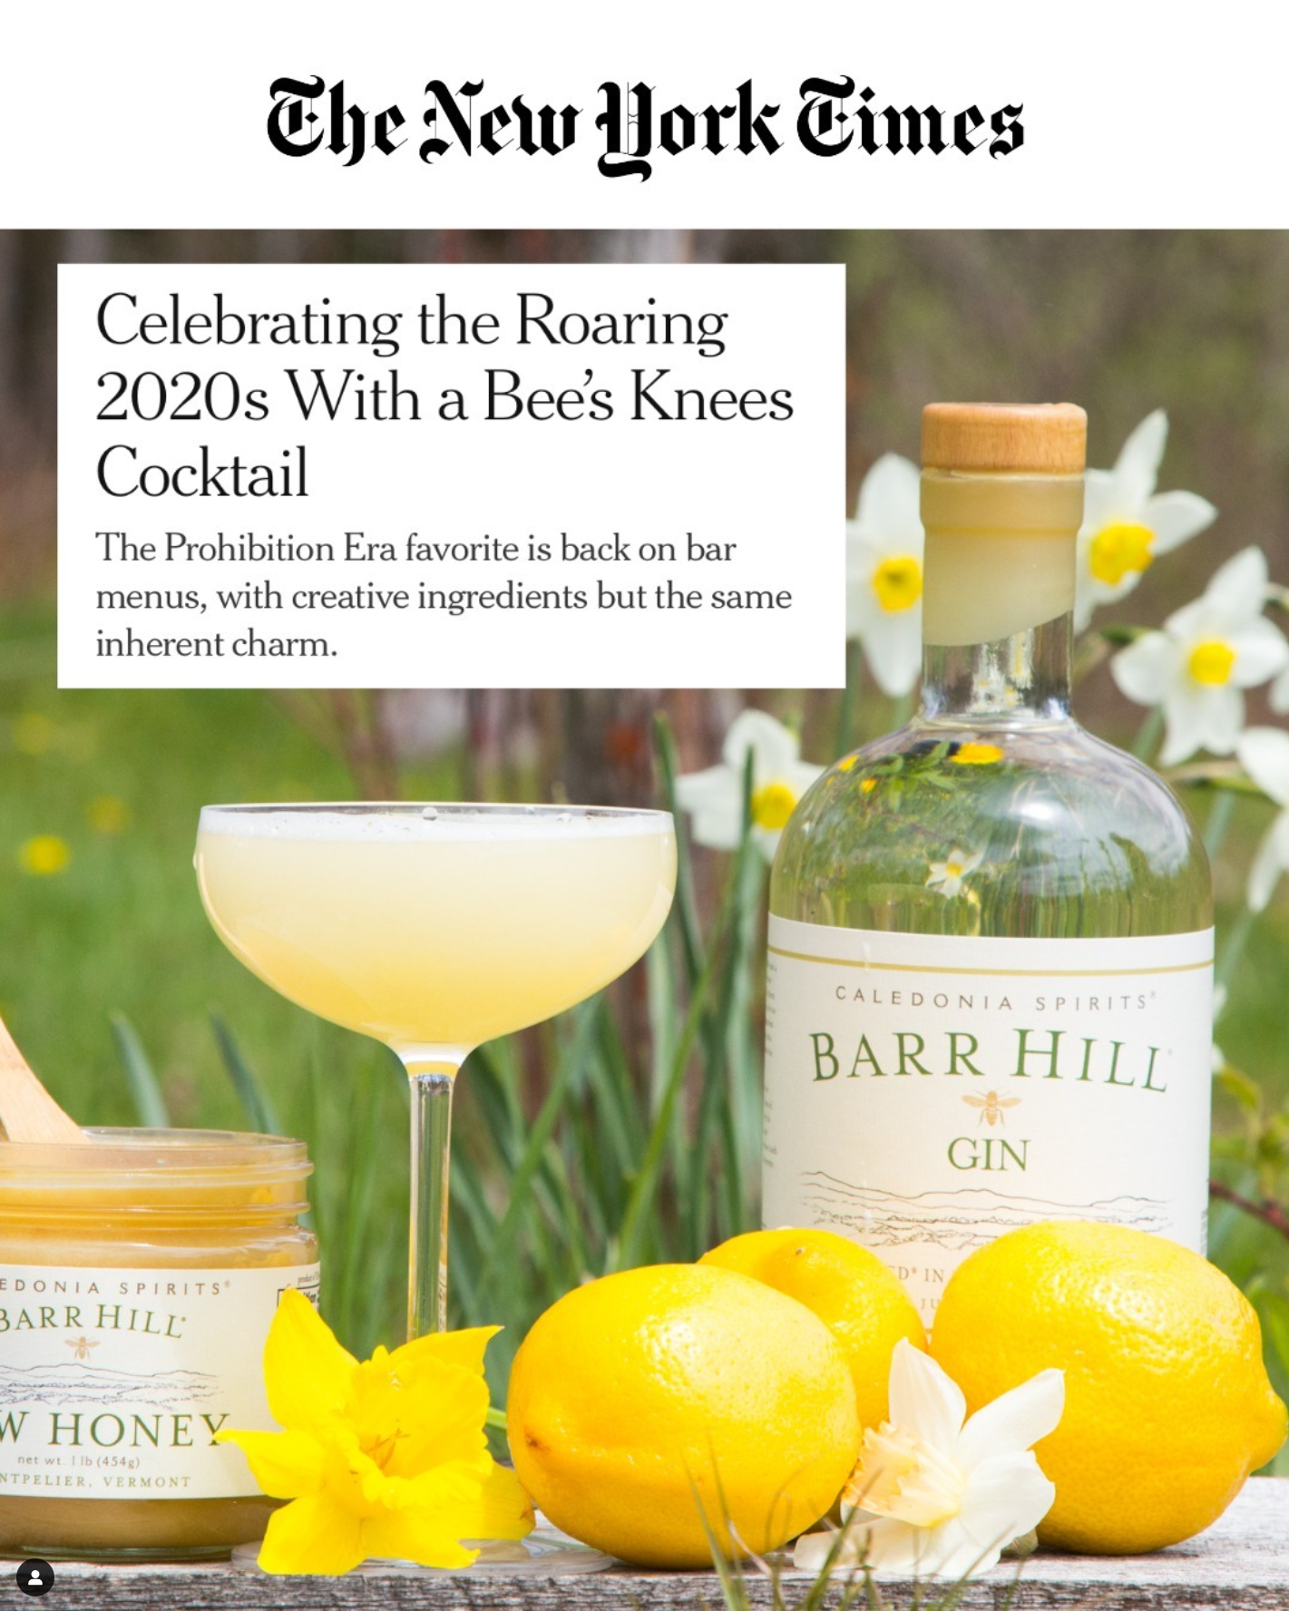
Barr Hill is Inspiring a Resurgence of the Bees Knees Cocktail
Link to full article here

